Slide 1






EFFECT OF COVID-19 ON EDUCATION IN AFRICA
DATA SCIENCE & ANALYTICS RESEARCH:
In partnership with

Slide 2

Using Technology to Breach The Gap in Education
THE TEAM:
Kate Ogochukwu Mercy Saniamo Habiba Sarhan
Unathi Mtwa Heba K. Ahmed Maxima Tibile
Mercy Akowe Precious Pitjeng Amarachukwu Eze

Slide 3
Background
COVID-19 has dramatically reshaped the way global education is delivered. Millions of learners were affected by educational institution closures due to the pandemic, which resulted in the largest online movement in the history of education.
Africa is one of the continents that is behind in technological advancements, and as such, things like online education were never a priority as there is so much ground to cover in implementing this way of learning and the costs are considered as “expensive”.
The pandemic regulations shut down the countries in March 2020, and as such schools were closed for a great number of weeks. Alternative means of learning is still a struggle for the previously mentioned reasons.
It is was also established in 2019, that the difference between internet accessibility to men and women in developed countries was only 3%, while in least developed countries had a significant difference of 11.1%. This could mean that African women are affected even more by covid-19

Slide 4


Slide 3
Hypothesis:
The global pandemic, covid-19 has affected many areas in our livelihood. While there are so many matters to look into, we have decided to explore its effect on education in African countries.
The covid-19 pandemic came with a shock that no one expected; affecting all aspects of life including the education of children. The aim of our analysis is to investigate the effect of covid-19 on education in African countries.

Slide 5
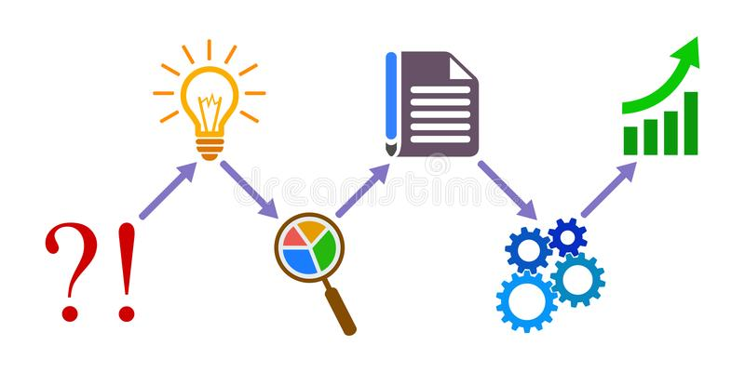
PROBLEM STATEMENT
In what ways did Covid-19 affect education in African Nations?
How effective was the transition to online learning in different African countries?
Does online Education work in all
African countries?
How can we facilitate equal education standards across low income and high income countries?

Slide 6
Project Objective
Our goal is to provide a comprehensive analysis on the effect of covid-19 on the education system of different African Countries.
Bridge the education gap in developed and underdeveloped countries by building a model App that fosters connections between students and teachers across low income and high income countries on various subjects areas.

Slide 7
Methodology
From our research we found limited datasets that speaks to our problem statement. The findings and analysis of our data were made from Excel datasets, these were cleaned and made ready for visualization.
Detailed tools used are the following:
❑ Microsoft Excel
• Pivot tables
• pivot chart
❑ Python
• Jupyter notebook
• External libraries: Geopandas
Our education pairing app was also built using Python.

Slide 8
Accordng to our data from UNICEF -https://data.unicef.org/topic/education/covid-19/ ,it showed that schools were closed for an average of 33 weeks; affecting school children. With Egypt having of sum during of partial and full closures for 20 weeks, Nigeria 24weeks, South Africa 37weeks, Kenya 37 weeks and Ghana 50 weeks. As seen in the plot below:

Slide 9
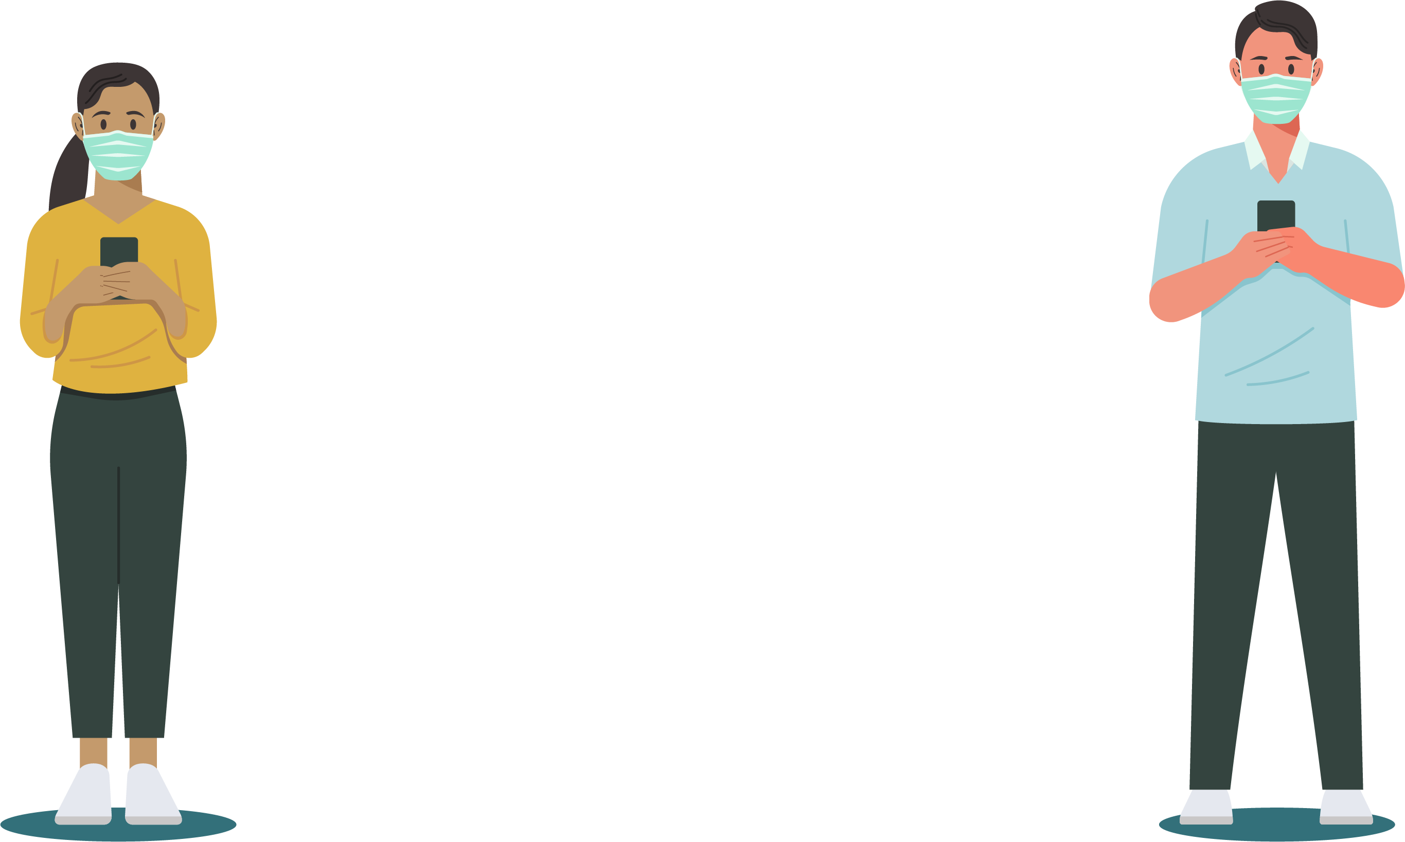

During this period, some school children were not learning due to inadequate resources for remote learning, while some students and more developed countries continued learning at home. This kept thousands of students especially African children away from school. This exposure we got lead to a research of African preparedness for remote learning. What made the difference why we couldn‘t engage well like other students in remote learning.
What made the difference? Let’s dive deeper into the analysis

Slide 10

Remote Learning Preparedness Checklist:
For remote learning to be carried out effectively, the following factors must be available
Computers
Cell phones
Internet
Electricity
Notes:
Once you find your sources, you will want to evaluate your sources using the following questions:
Author:
Who is the author?
Why should I believe what he or she has to say on the topic?
Is the author seen as an expert on the topic? How do you know?
Current:
How current is the information in the source?
When was the source published?
Is the information out-of-date?
Accuracy:
Is the content accurate?
Is the information presented objectively? Do they share the pros and cons?

Slide 11
For a closer look, we drew the graph above which outlined the huge gap internet connectivity.

Slide 12

The map in the next slide highlights the disparity in student’s access to internet in all countries. The darker colors as indicated in the legend symbolizes areas with poor internet access whereas those with lighter sheds symbolize areas with better internet connection. Areas in grey are those with missing data.
It is evident from the map that a greater percentage of students in Africa lack access to internet. This therefore means transition to online learning would be a challange in African countries.
The visualization was created in google Colab, where geopandas library was used to manipulate geospatial data.
Link to code
Link to data

Slide 13
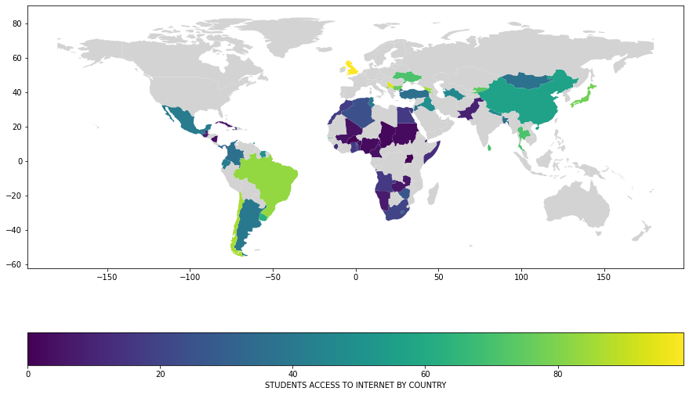

Slide 14

From our analysis, only 12% of Sub Sahara Africa have internet connectivity at home, 19% of West Africans has electricity, etc. Link to our data source https://mics.unicef.org/.
According to UNESCO-UNICEF Survey, school children in Africa engaged in online learning.
But the question is how effective was the learning? With no or little electricity, computers, internet connection.
What is the way forward?? From the analysis above, the margin between these regions is very clear. There is a huge gap that African countries need to catch up to.

Slide 15
Let’s take a closer look at the difference in internet connectivity between African regions and European countries.

Slide 16


In a bit to bridge the gap in the educational sector in Africa, we came up with the idea of a Tandem App.
Notes:
After consulting a variety of sources, you will need to narrow your topic. For example, the topic of internet safety is huge, but you could narrow that topic to include internet safety in regards to social media apps that teenagers are using heavily. A topic like that is more specific and will be relevant to your peers. Some questions to think about to help you narrow your topic:
What topics of the research interest me the most?
What topics of the research will interest my audience the most?
What topics will the audience find more engaging? Shocking? Inspiring?

Slide 17


Tandem APP
The tandem app is an application that would provide a platform for students and teachers in developing and developed countries to interact for the purpose of learning, and knowledge sharing on academic and socio-cultural aspects, with an aim to breach the gab in the educational sector as a result of the Covid-19 pandemic. It offers students the opportunity to find a match in other countries based on certain attributes they posses and topics/areas they may be interested in. The app also provide oppourtunity for entertainment
Notes:
Now, that you have narrowed your topic, you will want to organize your research in a structure that works. There are some common organizational patterns based on the kind of research you are doing.
Organizational Structures:
Cause and Effect- this kind of structure is great for explaining the causes and effects of a topic
Compare and Contrast- in this pattern you highlight the similarities and differences of the topic
Explain process- this structure is great for outlining a series of steps to follow;
Definition- if you want to make sure your audience understands what something is using illustrations, meanings, clarifying misconceptions, you may want to use this structure
Classification- a common organizational structure is grouping like topics or facts from the research together. For instance, in the internet safety about social media apps, you may organize the research where you look at each social media app one at a time

Slide 18
In conclusion, Covid-19 pandemic affected every aspect of lives including family, agriculture, finance, and education as seen from our analysis. The fight to the pandemic is not over yet. But we do hope that it doesnt must affect education like it did if we are better prepared for remote learning. Education being an important part of lives, remote learning has demonstated that, we are all interconnected. Therefore, Multisectoral collaborations and individual efforts are necessary to breaching this gap. We acknowlege the leaders of every country and everyone for the efforts made so far in the fight against the covid -19 pandemic and the efforts to bring remote learning onbaord in Africa to assist learning and growth. From here, we will move to Jupyter notebook to show you the Tandem App that will help students from all regions of the world communicate and learn from each other.
Notes:
After you’ve done your research, it’s time to put your presentation together. The first step in the process is to introduce the topic. This is a great time to connect your topic to something that your audience can relate. In other words, why should they listen to all the information you will be sharing in your research presentation? What is in it for them? You may also want to include a graphic or image to grab their attention.
Feel free to duplicate this slide by right-clicking on this slide in the slides pane to the left and select Duplicate Slide.
The next step in your presentation is to state your claim or topic clearly. Your teacher may even call this your thesis. As you state your thesis, you may find that this layout is not the best layout for your claim or topic. You can change the layout by clicking the drop-down menu next to the Layout in the Slides menu section. You can choose Two Content, Comparison, or Picture with Caption. Note: A different layout might change the look of the icons on this page.
You will also want to state your facts. You have done the research now share some of the interesting facts with your audience. Facts do not have to be boring; you can communicate facts in a variety of ways by going to the Insert Tab. In the Insert tab you can:
Insert pictures from your computer or online.
Add a chart
Create some SmartArt
Insert a variety of icons to help your facts come to life. Note: You can change the color of the icons by selecting the icon and then click on the Format tab and then Graphics Fill. From there, you will choose a color from the list or choose More Fill Colors to give you more options.
Since this research presentation is a result of your hard work and searching, you want to make sure you support the claims or points in your presentation with facts from your research findings. Make sure you give the author proper credit for helping you share your ideas. If one of your sources has a video that is relevant to your topic, you can add the video as added support. Keep in mind the length of the video and the amount of time you have for your presentation. For a 5 minute speech, the video should be no longer than 30 seconds.
Questions to consider:
How will you state the author of the source?
Will you need to cite the source on the slide?
What are some ways you can engage your audience so they feel like they are a part of the presentation? Some ideas to consider is by taking a quick poll like: by a show of hands, how many of you think school uniforms are a way to cut down on bullying? Another suggestion is to have them hold up a certain number of fingers to see if they agree or disagree. Finally, you can share a story that the audience can relate to that makes them laugh.
After all the applause, your audience may have some questions. Be prepared to answer some of their questions by making a list of questions you think they might ask. You may also want to share the presentation with them by providing the link to your presentation, if they want more information.

Slide 19
THANK YOU!
Notes:
You can use this slide as your opening or closing slide. Should you choose to use it as a closing, make sure you review the main points of your presentation. One creative way to do that is by adding animations to the various graphics on a slide. This slide has 4 different graphics, and, when you view the slideshow, you will see that you can click to reveal the next graphic. Similarly, as you review the main topics in your presentation, you may want each point to show up when you are addressing that topic.
Add animation to images and graphics:
Select your image or graphic.
Click on the Animations tab.
Choose from the options. The animation for this slide is “Split”. The drop-down menu in the Animation section gives even more animations you can use.
If you have multiple graphics or images, you will see a number appear next to it that notes the order of the animations.
Note: You will want to choose the animations carefully. You do not want to make your audience dizzy from your presentation.

